Slide 1
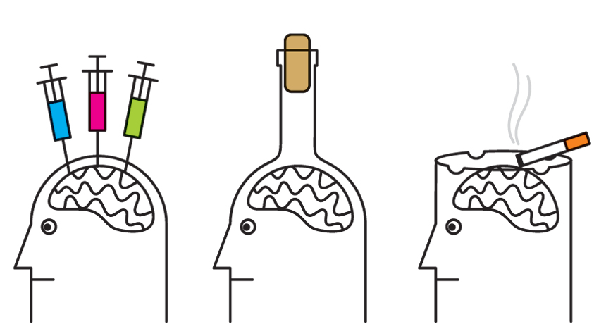
Addiction

Slide 2
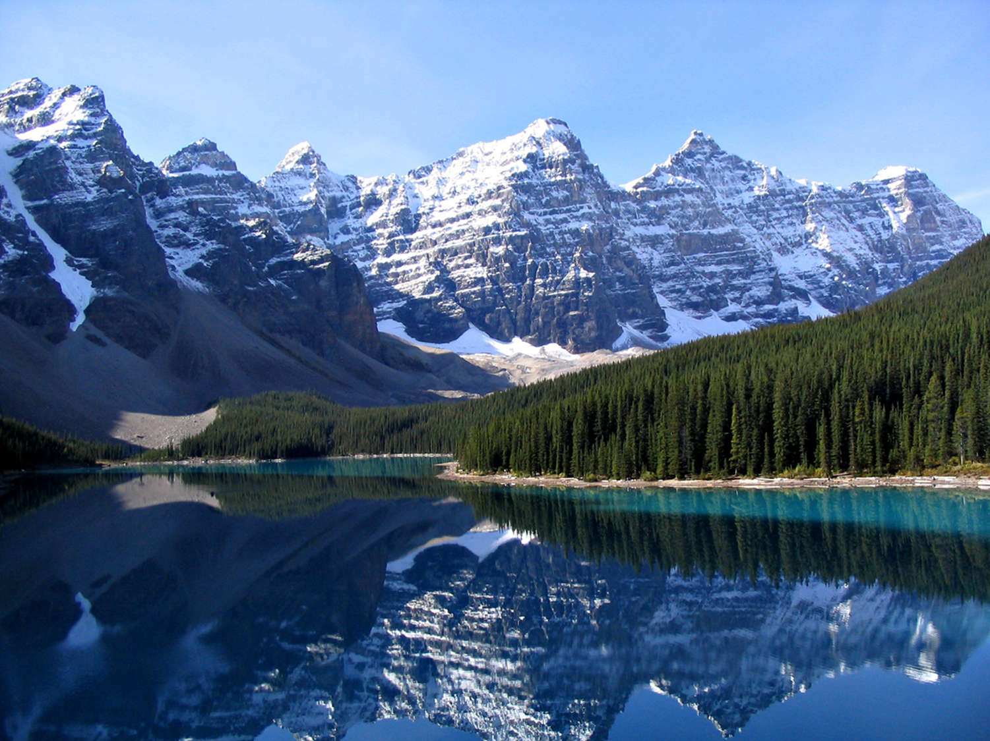
Nancy V. Rodway MD MS MPH FACOEM
Medical Director Lake County General Health District
Occupational and Preventive Medicine
Anatomic and Clinical Pathology

Slide 3
Objectives
Provide an overview of the physiology of and risk factors for addiction, especially for the teenager
Provide detailed information about the opiate epidemic and local community response
Jump into legalization of marijuana: the medical and regulatory consequences

Slide 4
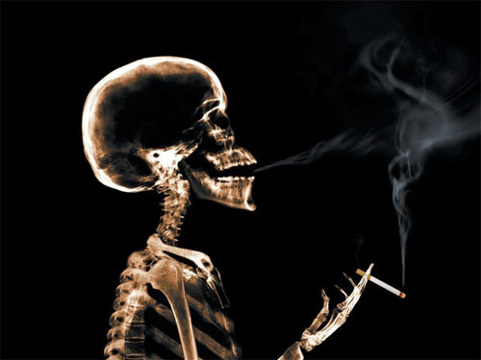
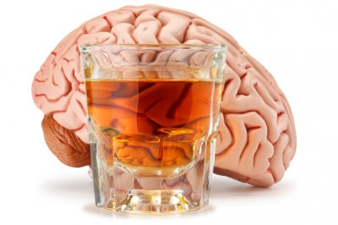
Addictions

Slide 5
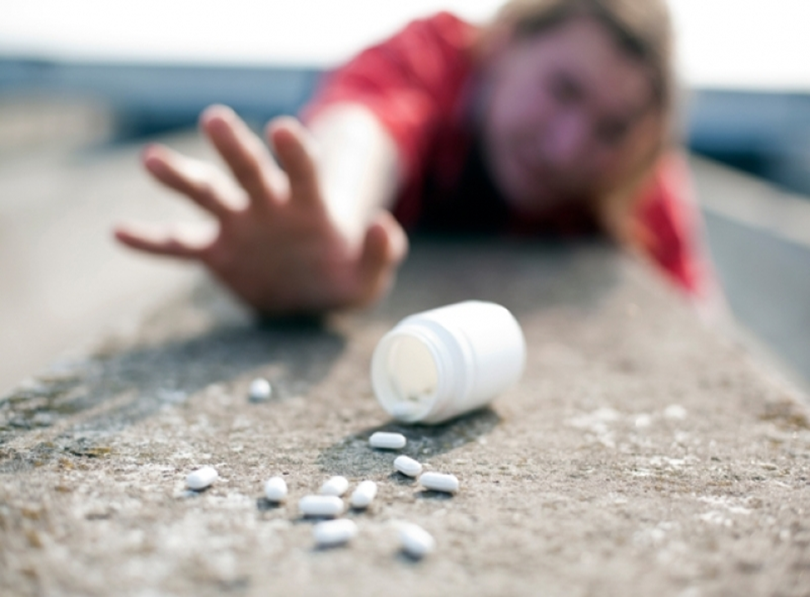

Slide 6
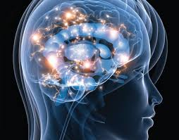
Addiction
Is a disease of the brain in which drugs or actions change the structure and function of the brain, leading to harmful, sometimes permanent, effects

Slide 7
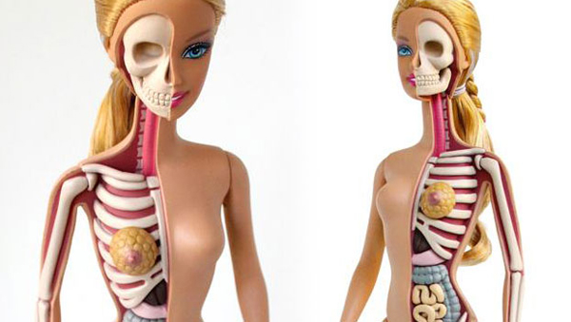
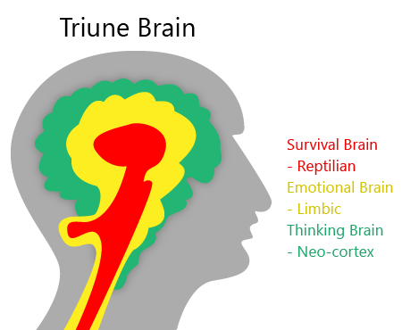
Anatomy 101

Slide 8
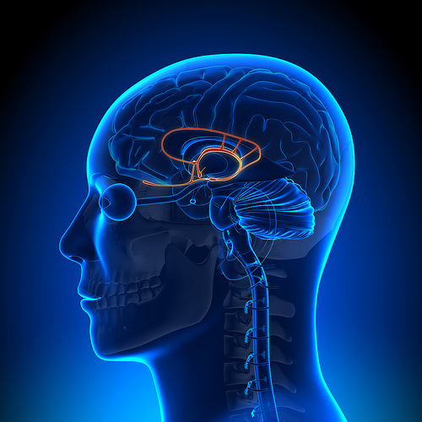
The mammalian (limbic) part of the brain controls your emotions by releasing happy and sad chemicals
Sometimes it doesn’t talk to the thinking part of the brain

Slide 10
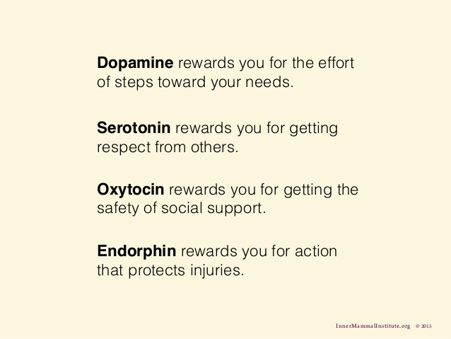
Pleasure
Importance
Love
Runner’s High

Slide 11
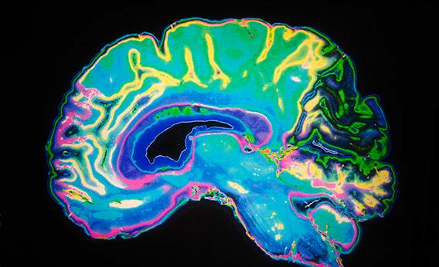
Dopamine

Slide 12
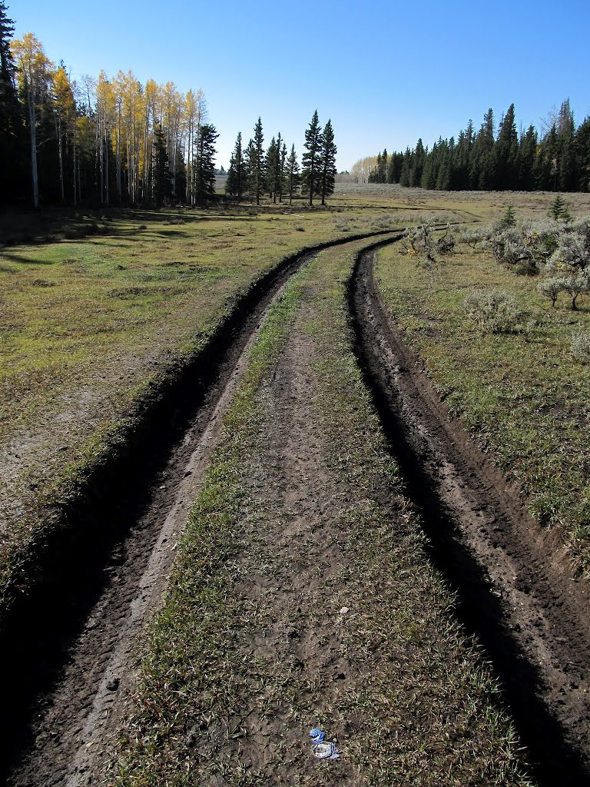
Nerves impulses like familiar roads
Regardless if the outcome is good or bad

Slide 13
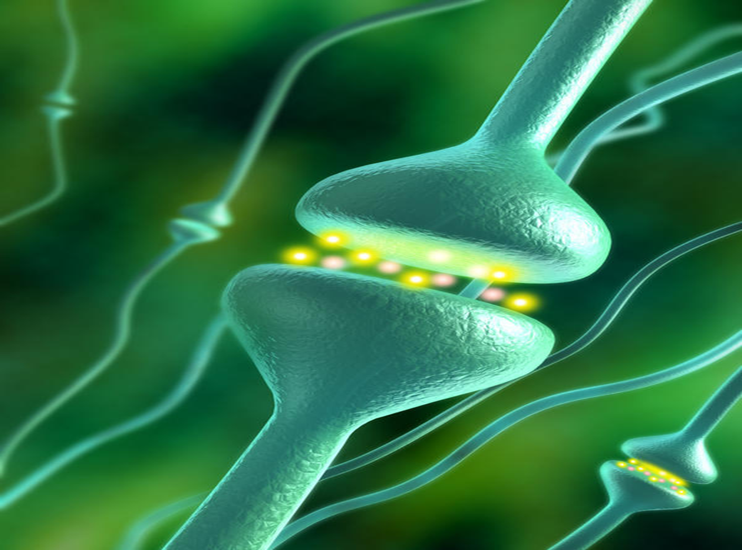
Brain nerves trigger cells to release mood-altering chemicals

Slide 14
DOPAMINE

Slide 15
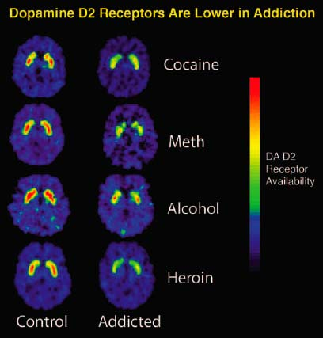

Slide 16
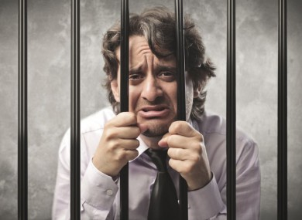

Slide 17
Some brain cells have special chemical buttons to push

Slide 18
Opiates Nicotine Cannabis
Memory
Appetite
Pain
Mood
Immunity
Dopamine
Dopamine

Slide 19
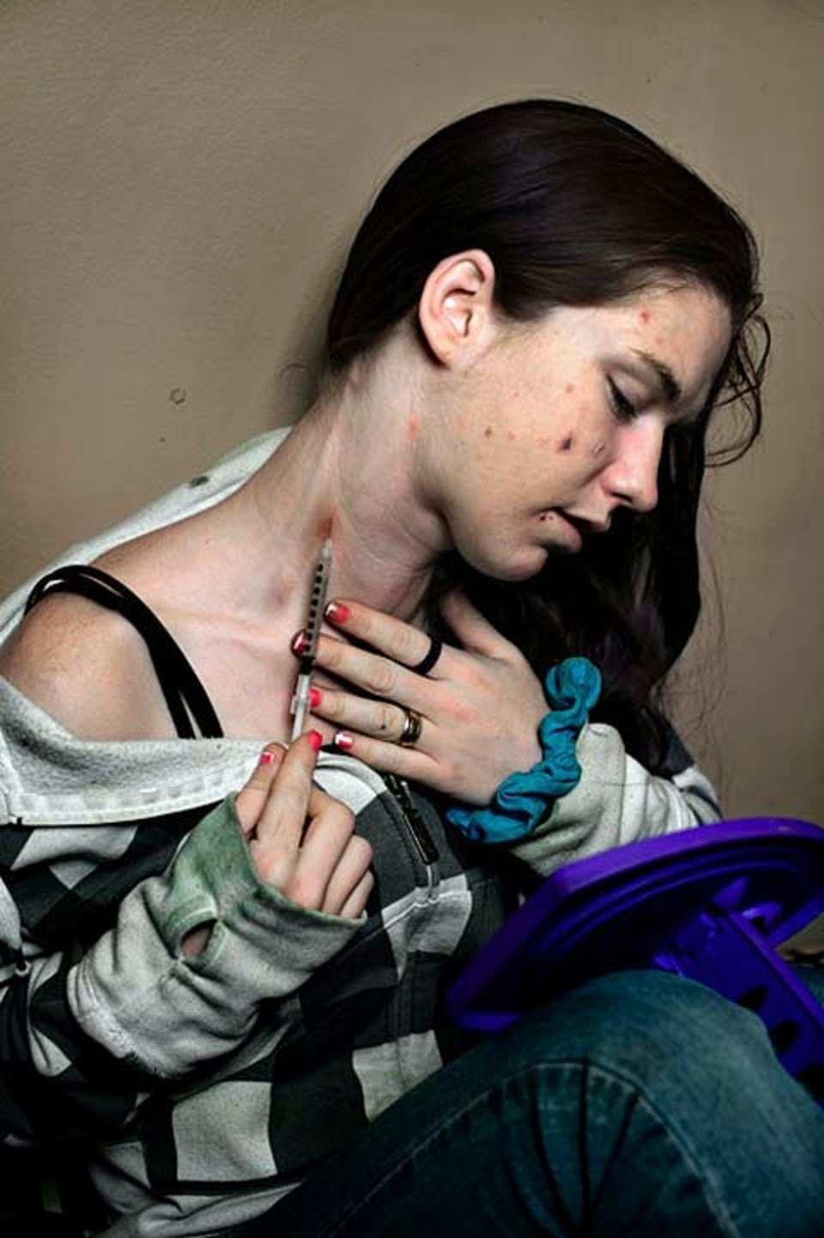
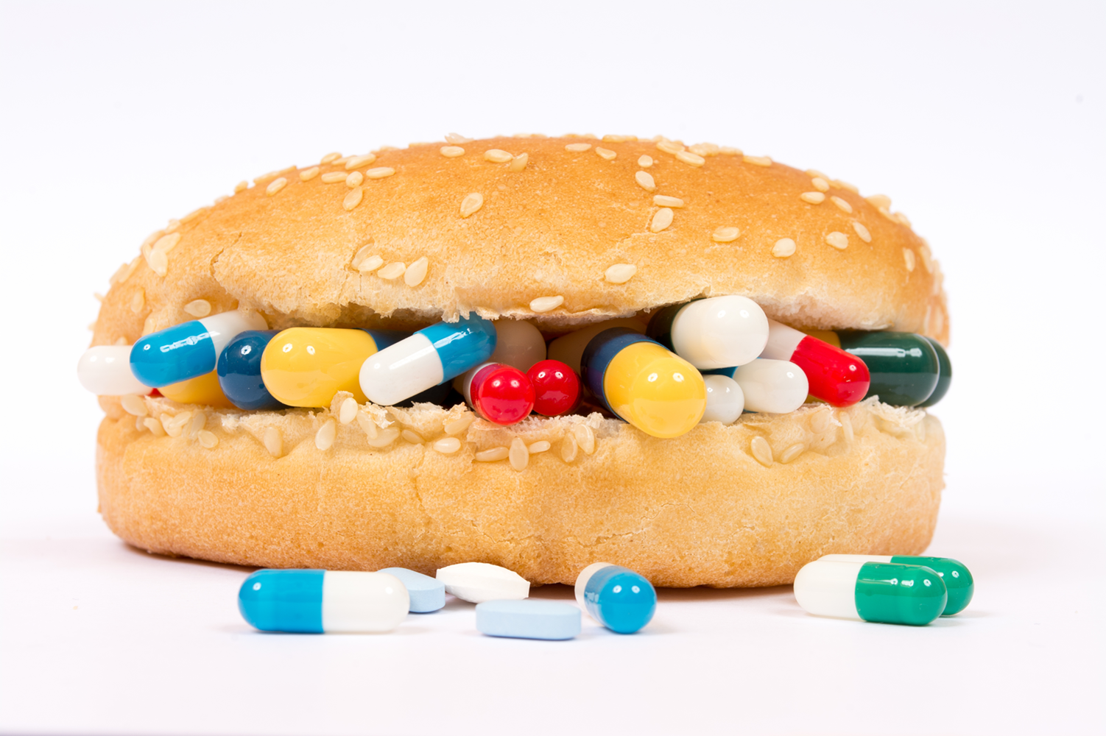
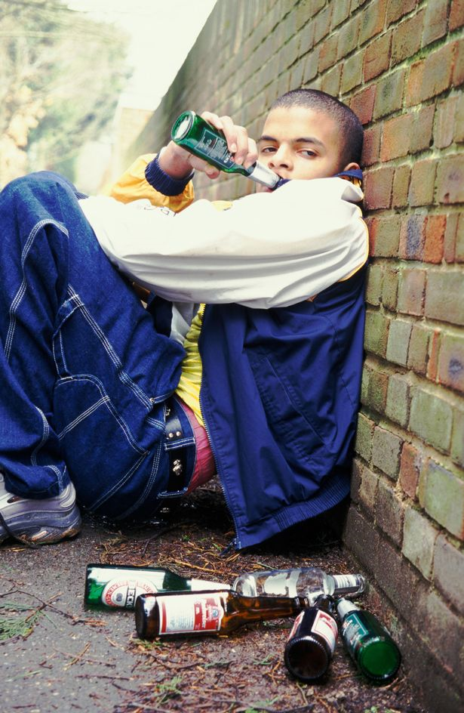
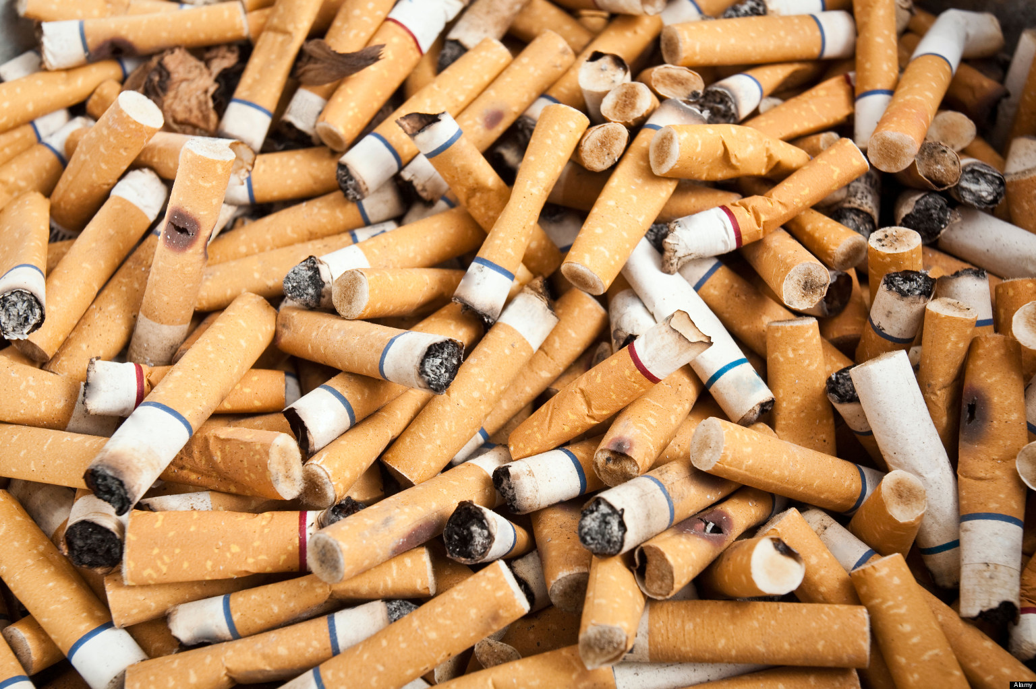

Slide 21
Addiction steps
First use is voluntary
Nerve pathways opened then “greased”
Cellular changes with one dose
Self control then impaired (hallmark of addiction)
Need more stimulation to achieve the same effect
Brain shows visible changes in three months

Slide 22
Addiction Risk Factors
Aggressive behavior in childhood
Lack of parental supervision
Poor social skills
Availability of drugs in school
Community poverty
Social isolation for girls
Lack of extra-curricular activities for boys
NIDA Drugs, Brains, and Behavior. The Science of Addiction July 2014 Pub No. 14-5605
The Teenage Brain by Frances E. Jensen, MD

Slide 23
The teenage brain is ripe for addiction

Slide 24
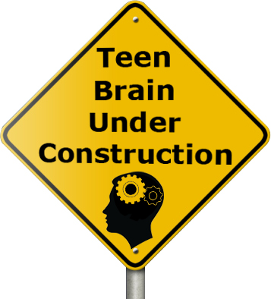

Slide 25
Human brain
Not fully developed until mid to late 20s, especially males
The frontal lobe EXECUTIVE FUNCTION is NOT CONNECTED TO EMOTION CENTER
The teenage brain makes more dopamine and has more excitatory neurons; few inhibitory ones
Teenage years: anatomically is best time in life to learn new behaviors, even bad ones

Slide 26
Addiction is hardwired into the teenage brain
If a person is exposure to an addictive substance before the brain is mature (mid-20s), the frontal brain (executive brain) has little control over the “decision,” the nerve pathways formed are far stronger, and the dopamine reward is far more intense. Rehabilitation is far more difficult

Slide 27
Addictions starting in teenagers/young adults are neurologically, chemically and behaviorally worse
Rehabilitation less successful

Slide 28
What can a parent do?
Fear of losing their parent’s trust and respect is the greatest deterrent to drug use
Set an example
Control the environment
Limit exposures to stressful events

Slide 29
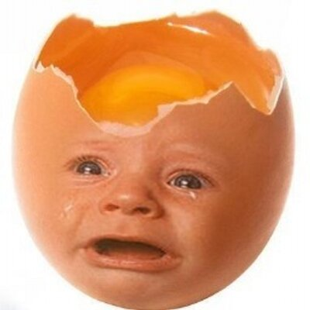
The sad chemical is cortisol

Slide 30
Cortisol helps mammals respond to anticipated stressors
Our brain can create virtual stressors

Slide 31
Too much cortisol
Can lead to depression
Can lead to addictions

Slide 34
Treatment of addictions

Slide 35
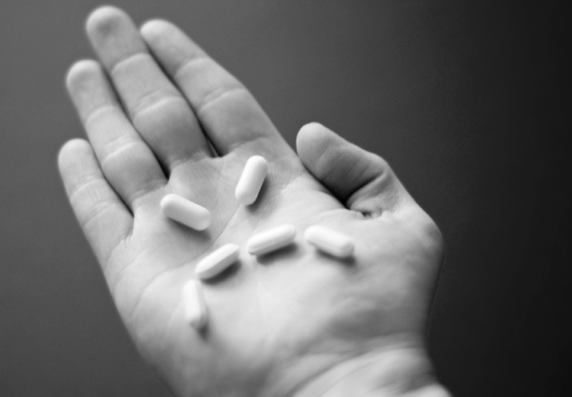
Treatment starts with withdrawal
Withdrawal from opiates is not fatal
Withdrawal from alcohol/benzodiazepines can be

Slide 36
Treatment of addiction
Intense treatment should last 90 days
Medications specific to condition
Behavioral therapy
Best when used together
EXPECT RELAPSES, similar to nicotine

Slide 37
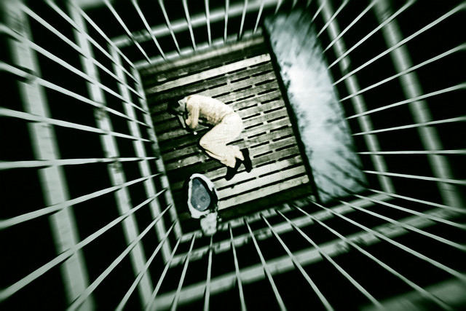
Addicts who enter treatment under legal pressure
Have as favorable outcomes as those who enter treatment voluntarily
NIDA’s Principles of Drug Abuse Treatment for Criminal Justice Populations: A Research-Based Guide.

Slide 38
Remember that addiction is a chronic disease
There will be flare-ups
It will take time

Slide 39
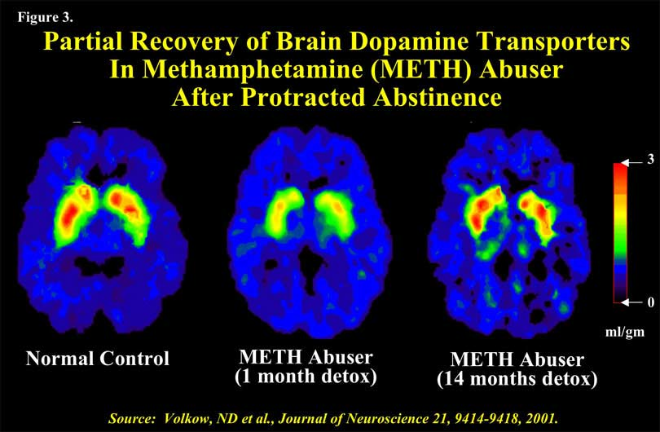

Slide 40
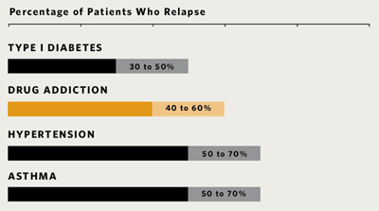
Relapse rates of chronic illnesses
NIDA Principles of Drug Addiction Treatment, A Research-based guide, 3rd edition, 2012

Slide 41
Medications for recovery
Tobacco
Nicotine replacement
Zyban (Wellbutrin, bupropion)
Varenicline (Chantix)
Opiates
Methadone
Suboxone
Naltrexone (Vivitrol injection, pills, implant)
Ambulatory Detoxification medications
Alcohol
Naltrexone (Vivitrol injection, pills)
Disulfiram (Antabuse)
Campral (acamprosate)

Slide 43
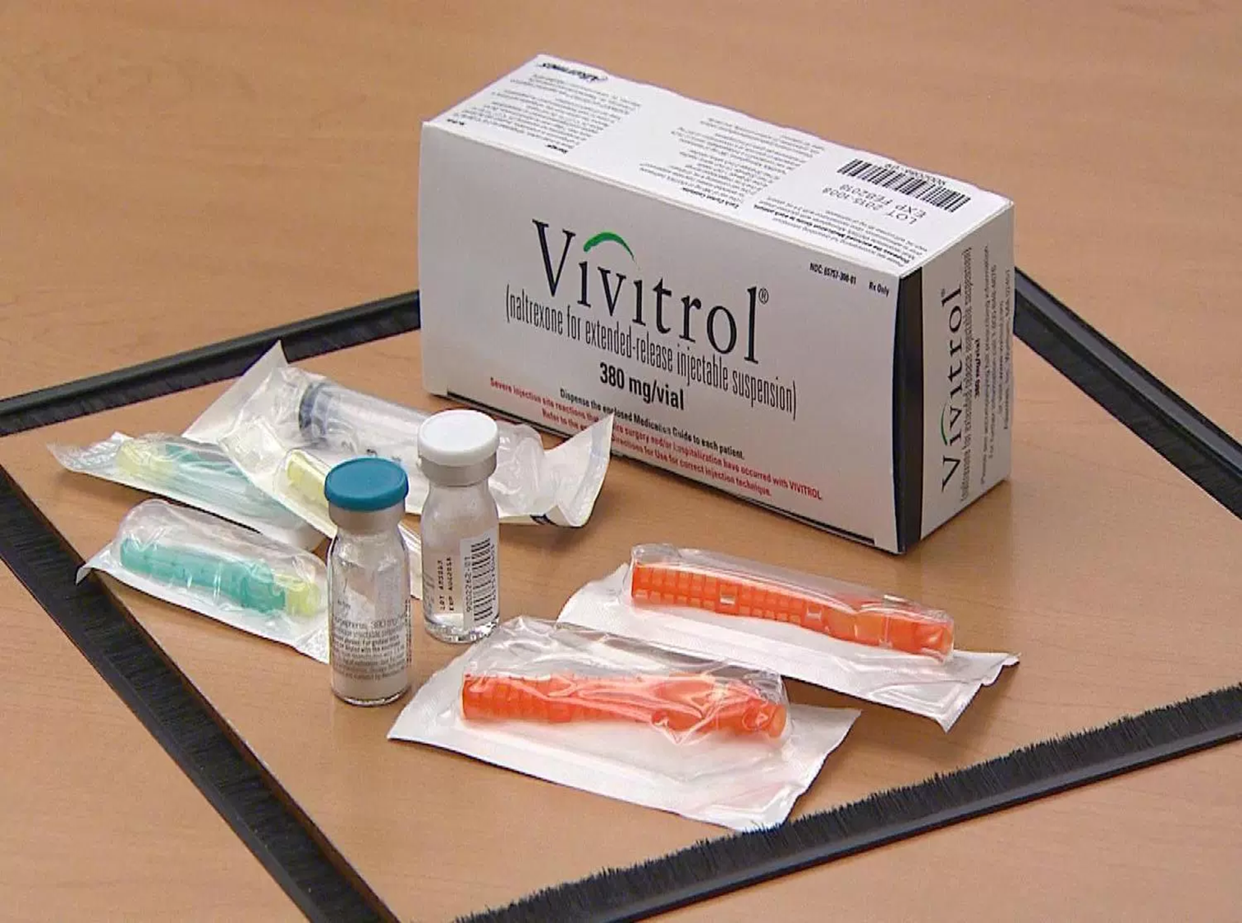

Slide 44
Prevention of addictions
Regulatory
Taxes on substances
Prescribing regulations
School anti-drug policies
Community
Positive relationships
Neighborhood pride
Random drug programs at work
Personal
Good self control
Parental monitoring and support
Academic competence

Slide 45
Preventing Addictions in Children
Fear of losing their parent’s trust and respect is the greatest deterrent to drug use
Set an example
Control the environment
Limit exposures to stressful events

Slide 46
Opiate overdose

Slide 47
Opiates kill by suppressing breathing
Narcan reverses this

Slide 48
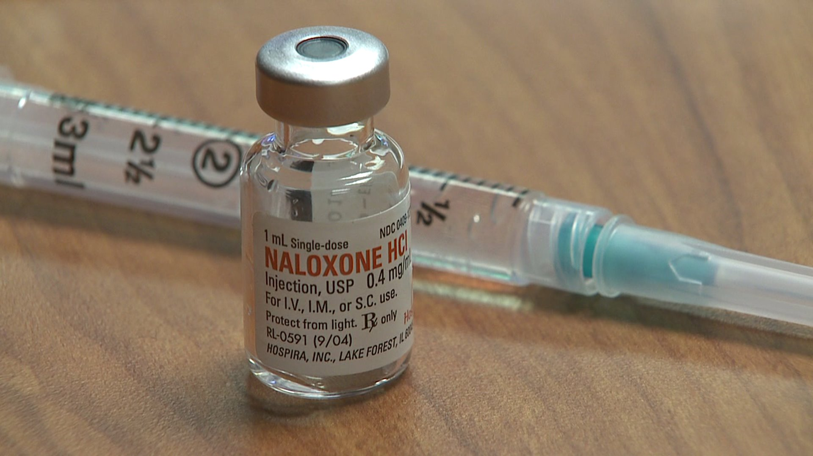
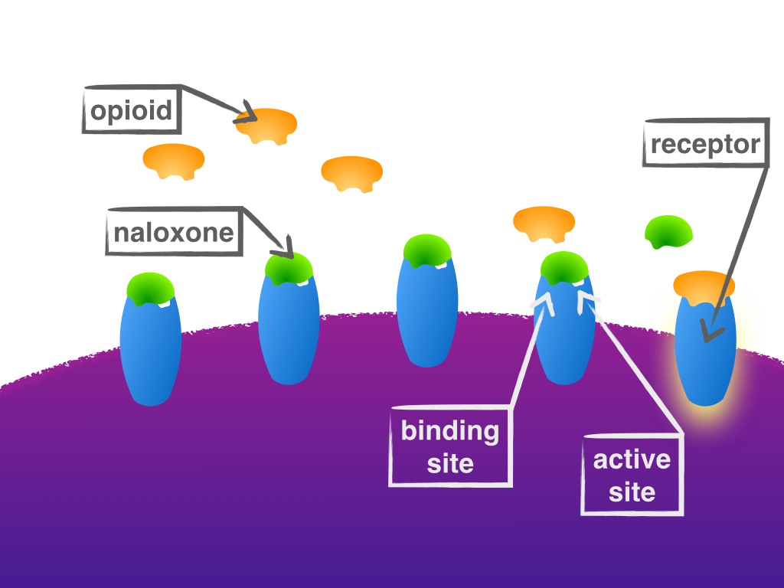
Narcan/naloxone

Slide 49
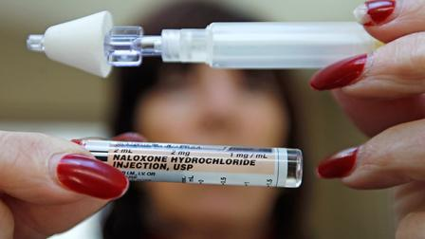

Slide 50
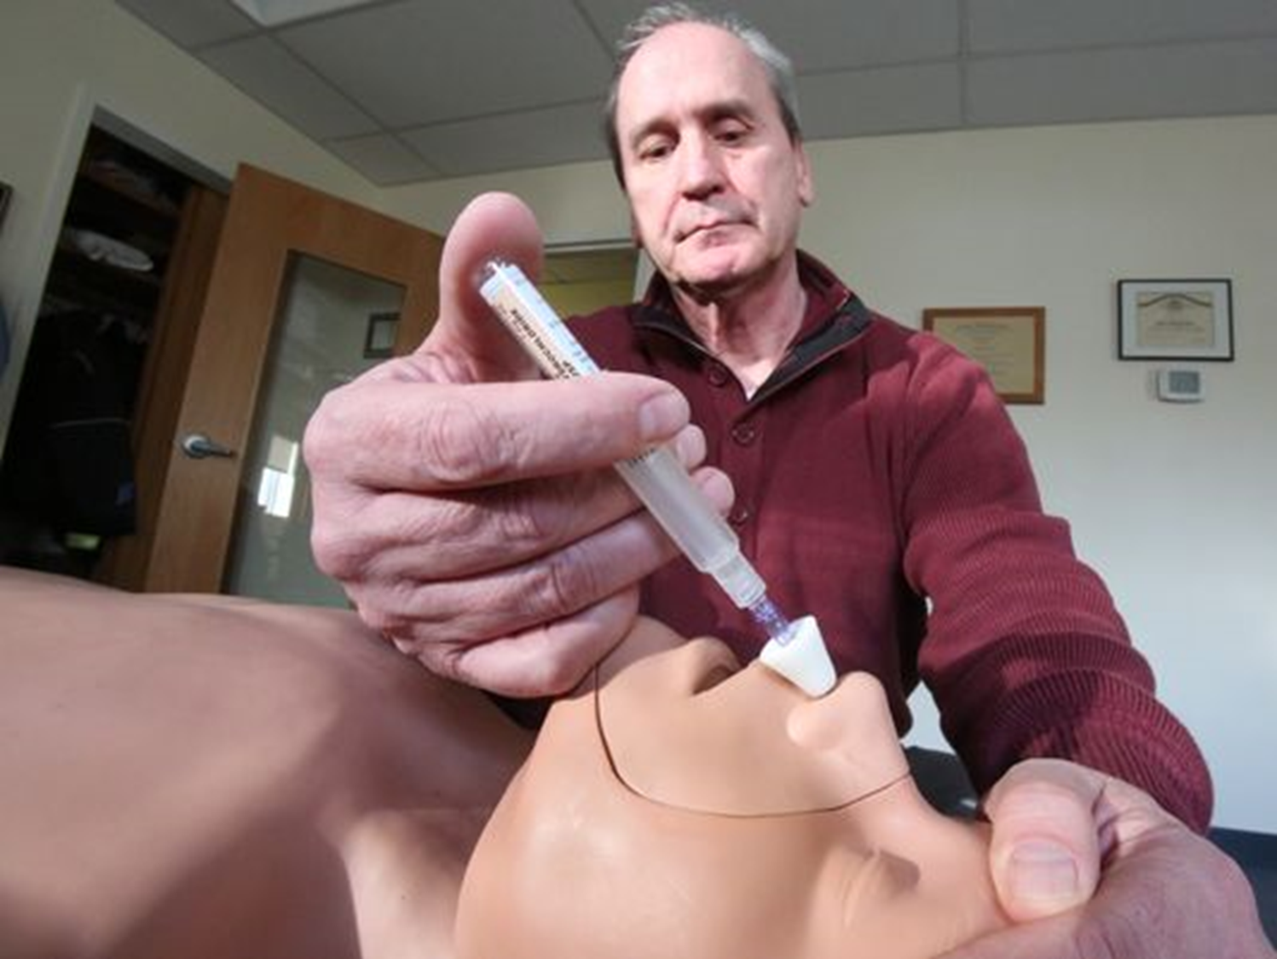

Slide 51
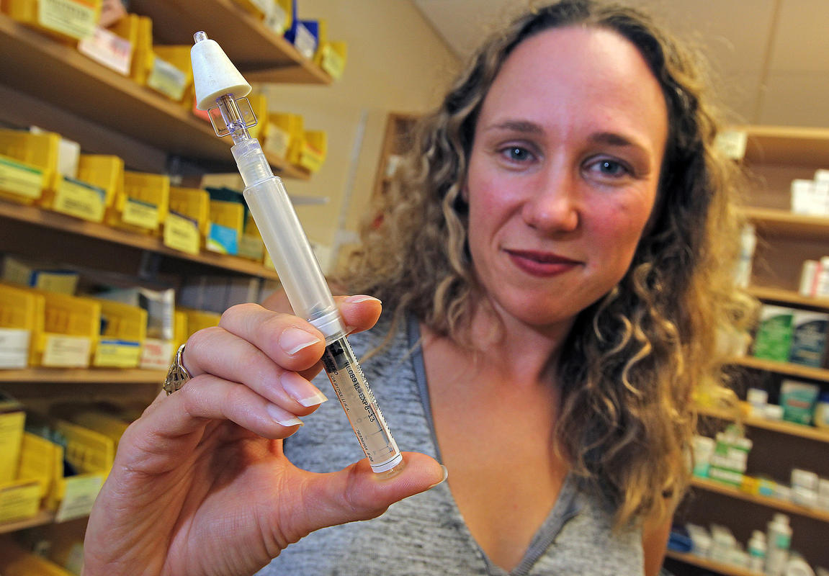
CVS Pharmacies: nasal Narcan available without a prescription

Slide 52
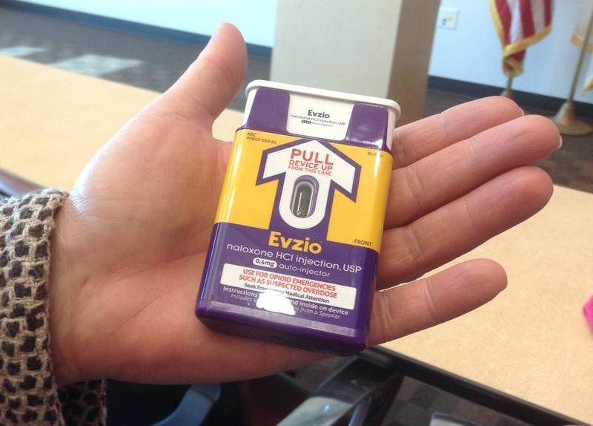
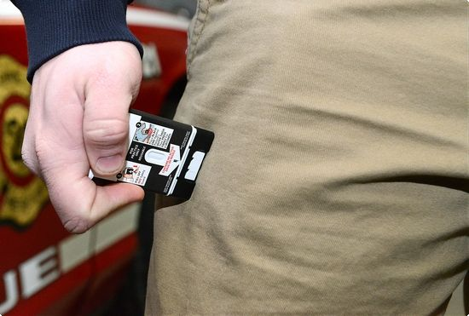

Slide 53
Narcan for addicts
Recommended by the state of Ohio
Recommended by the CDC
Recommended by the AMA
Some studies show increase rates of recovery after overdose reversal with narcan
“Lazarus parties” may be urban legend

Slide 55
19,000 American died from opiates in 2014
Marijuana has no overdose threshold
Downs, David. “The Science behind the DEA’s Long War on Marijuana,” Scientific American, 4/19/2016.

Slide 56
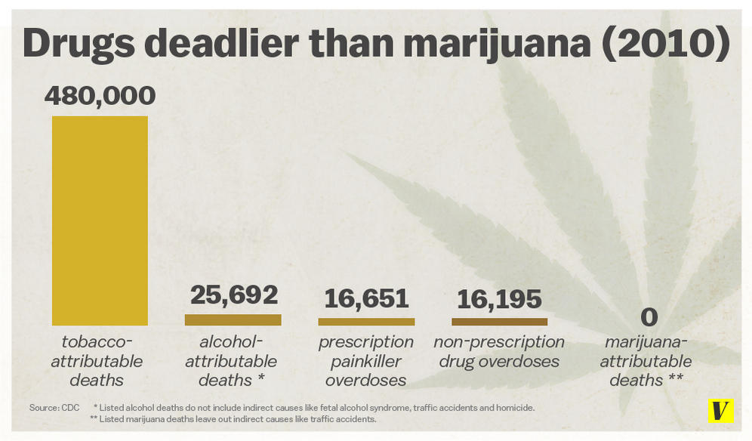

Slide 57
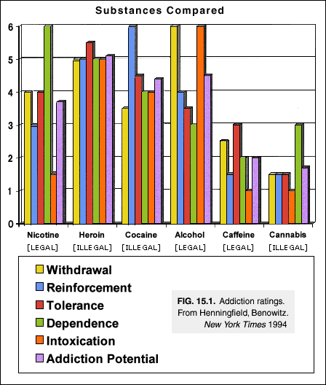

Slide 58
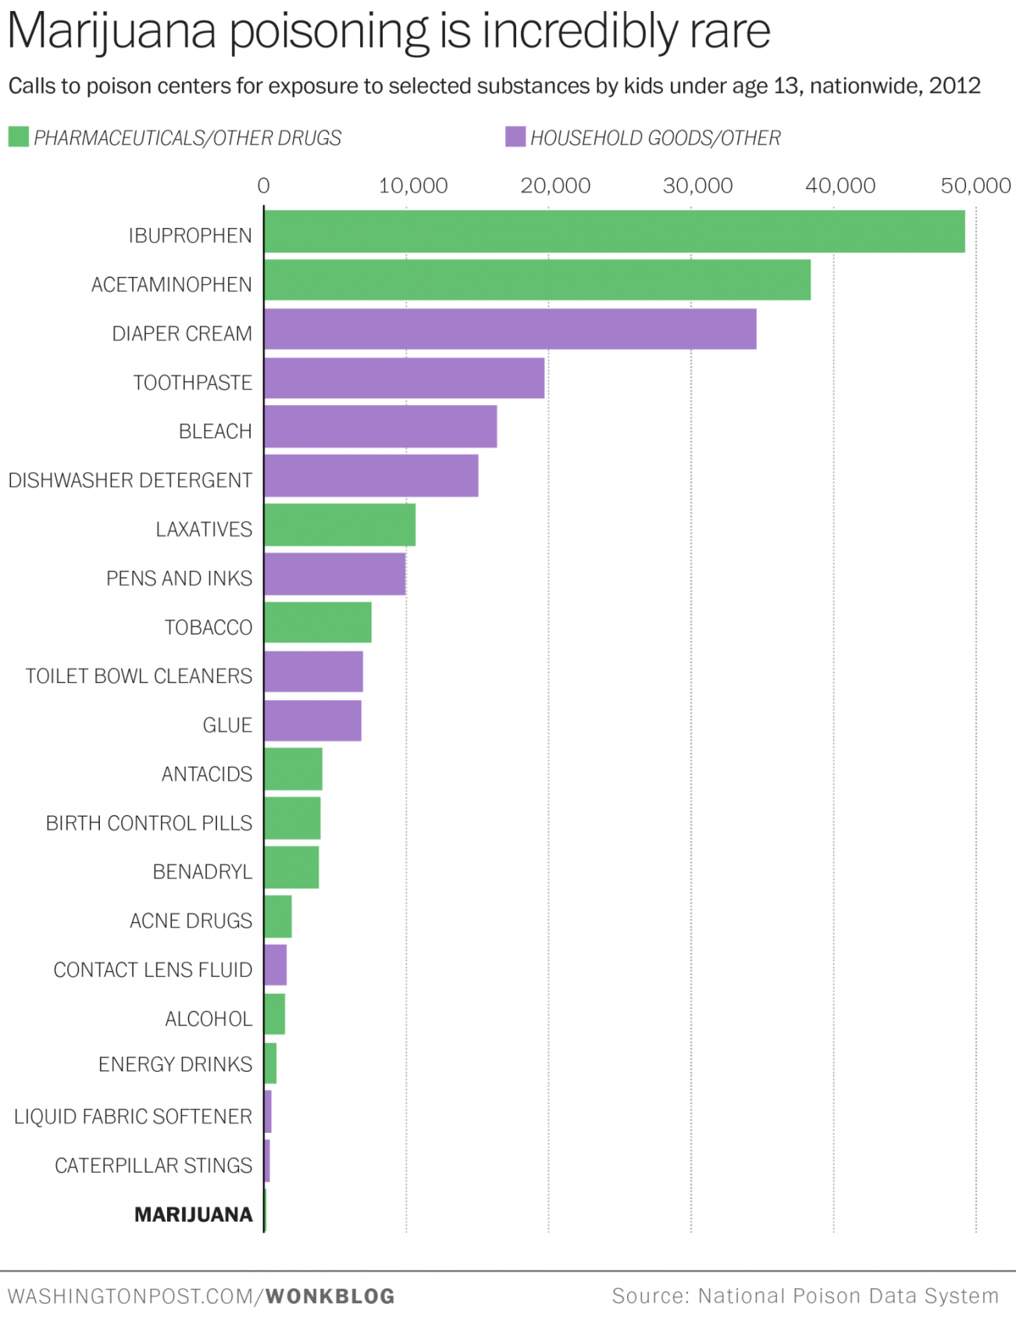

Slide 59
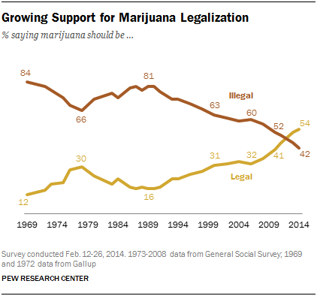

Slide 60
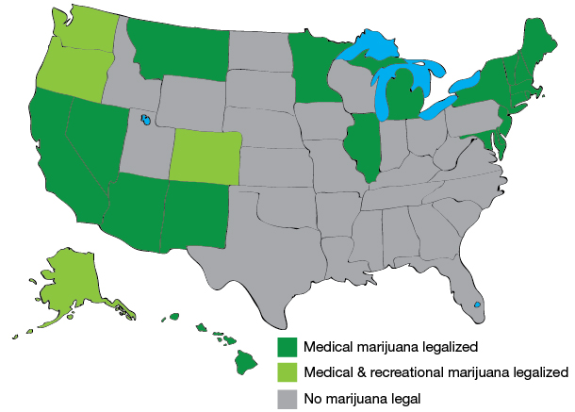

Slide 61
Marijuana/Cannabis history
Has been used medically for thousands of years
Cannabis has a natural receptor in the brain
Cannabis was a medicine in the United States until 1942 when regulations started
Cannabis “makes white women and black men have sex.”*
* Martin Lee in Smoke Signals: A Social History or Marijuana

Slide 62
MJ and the Law
Increased use of MJ in 1960s and 1970s
Congress passed Controlled Substances Act in 1970
Established MJ as Schedule I drug similar to heroin (high potential for abuse, no legit med use)
The AMA fought the law

Slide 63
“I want a goddamn strong statement on marijuana…that just tears the ass out of them.”

Slide 64
Controlled Substances Act
Cannabis became a Schedule 1 drug as having “no medical use and a high potential of abuse” similar to HEROIN
Limits government research dollars to studies of the dangerous effects of cannabis
NIDA controls the supply of cannabis for research

Slide 65
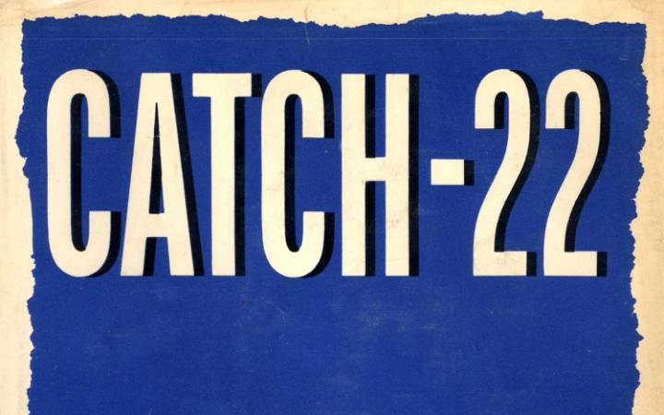
The only legal source of cannabis is the NIDA which has a congressional mandate to only study its harms.

Slide 66
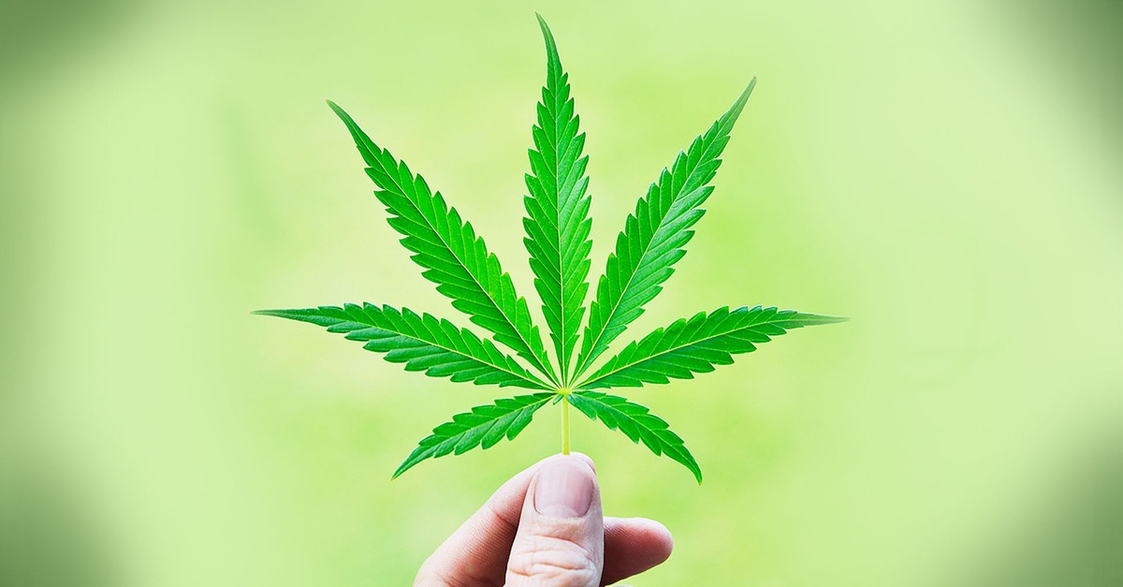
Marijuana

Slide 67
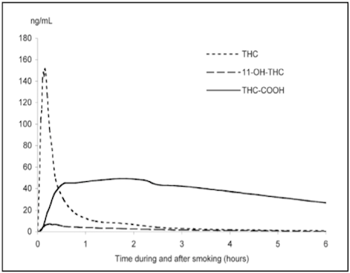
Marijuana
Active metabolite
Inactive metabolite
Active metabolite

Slide 68
Presence of drug does not = impairment
Impairment based on road-side or clinical impairment testing

Slide 69
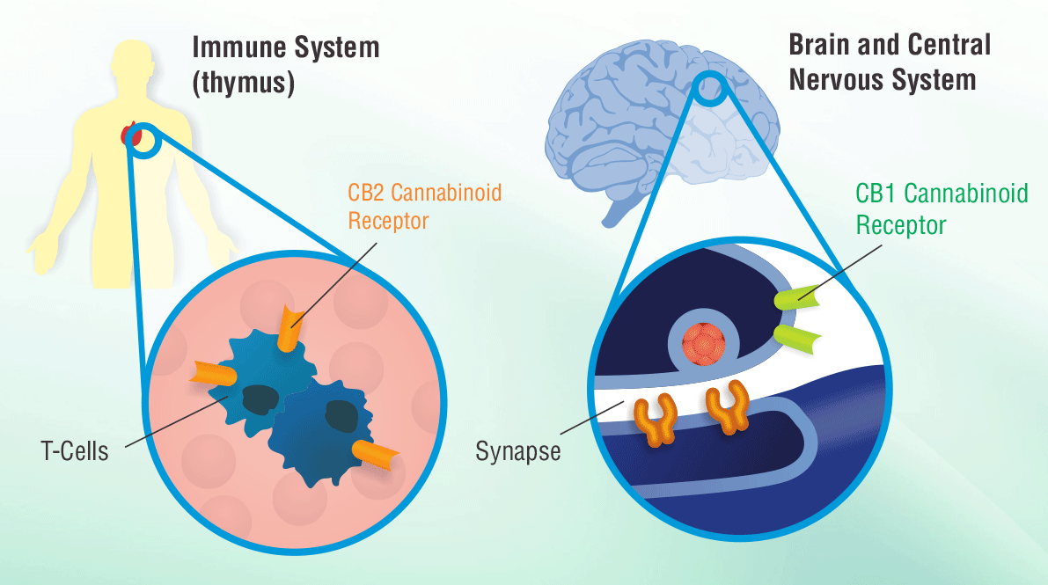

Slide 70
Scientific studies indicates that cannabinoid drugs, primarily THC, is indicated for pain relief, nausea and vomiting, and appetite stimulation. Smoked marijuana, however, is a crude THC delivery system that also delivers harmful substances.
http://medicalmarijuana.procon.org/sourcefiles/IOM_Report.pdf

Slide 71
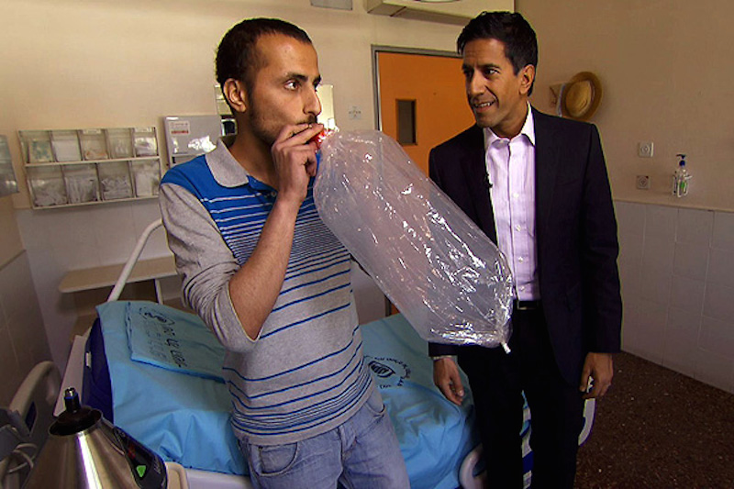
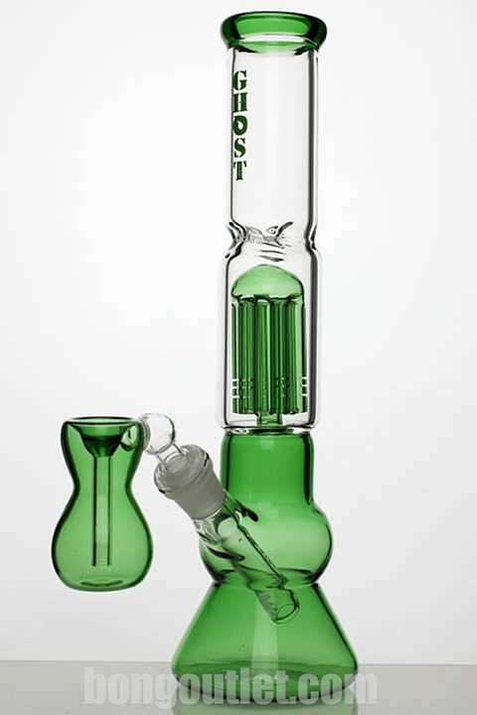
Vaporizing marijuana

Slide 73
Marijuana Side Effects:
Does not cause significant lung harm
Does not weaken the immune system
Does not cause cognitive impairment beyond the acute “buzz”
Does not cause addiction!
1.5 to 9% of recreational users become addicted (and these may be from childhood use)
Unknown addiction potential in medical users

Slide 74
Marijuana Side Effects
Does not cause long term brain effects*
Effect on developing brain (teenagers) likely dangerous and needs more study
Psychosis may be worsened during acute intoxication so caution if comorbidity
Acute intoxication affects attention memory and perception
Withdrawal syndrome exists and is mild at best

Slide 75
Marijuana as a medicine
Effective in:
Chronic neuropathic or cancer pain
Spasticity
Nausea and vomiting
Weight loss
Glaucoma
Opiate addiction to diminish opiate dependence

Slide 76
Marijuana as a medicine:
Likely to be effective in:
Fibromyalgia
PTSD
Seizure disorders (children*)
Irritable Bowel Syndrome/Crohn’s disease

Slide 77
Marijuana SHOULD NOT be used by:
Anyone with a personal or family history of psychoses like schizophrenia
Age younger than 18 years
Pregnant women
Breastfeeding women

Slide 78
Marijuana as a gateway drug:
Marijuana often precedes other drug use however alcohol and nicotine precede marijuana use. Thereby, marijuana is rarely THE gateway drug.
There is no convincing evidence that legalization will lead to more use within the general population*
Marijuana does not trigger significant dopamine production, unlike alcohol and nicotine
http://medicalmarijuana.procon.org/sourcefiles/IOM_Report.pdf

Slide 79
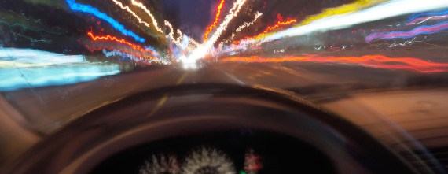
Drugged Driving
Colorado reported 1 of 5 MVAs due to marijuana

Slide 80
National Highway Traffic Safety Administration DOT HS 812 117 research note Feb 2015
Case-control study of alcohol and drugs in crash-related drivers and controls in Virginia in 2012
Case n = 3682 Control n = 7176
All drivers tested for drugs and alcohol
96.2% participation rate

Slide 81
NHTSA RESULTS
Drug | RISK OF CRASH Odds ratio compared to no drugs | 95% CI | P Value
Marijuana | 1.00 | 0.83-1.22 | 0.98
Antidepressants | 0.86 | 0.56-1.33 | 0.50
Narcotics | 1.17 | 0.87-1.56 | 0.30
Sedatives | 1.19 | 0.86-1.64 | 0.29
Stimulants | 0.92 | 0.70-1.18 | 0.51

Slide 82
NHTSA RESULTS
BLOOD ALCOHOL (BREATH TEST) | RELATIVE RISK FOR CRASH ADJUSTED FOR AGE AND GENDER
0.00 | 1.0 (REFERENCE)
0.03 | 1.20
0.05 | 2.07
0.08 | 3.93

Slide 83
Impaired driving study in Netherlands DRUID study
Tested 3,800 drivers for drugs and alcohol
Did not find significant increased risk of injury associated with the use of amphetamine, cannabis, cocaine, ecstasy when taken alone.

Slide 84
DRUID Case-Control MVI risk 2012 N=50,000
 | Substance | Increased relative risk of serious injury or fatality | Risk of injury
Alcohol | 0.1 – 0.5 g/L | 1-3x | Slightly increased
 | 0.5 – 0.8 g/L | 2-10x | Moderately increased
 | 0.8 – 1.2 g/L | 5-30x | Highly increased
 | > 1.2 g/L | 20 – 200x | Extremely increased
Illicit drugs alone | Amphetamines | 5 – 30x | Highly increased
 | Cocaine | 2 – 10x | Moderately increased
 | THC (marijuana) | 1 – 3x | Slightly increased
 | Illicit opiates | 2 – 10x | Moderately increased
Medicines | Benzodiazepines | 2 – 10x | Moderately increased
 | Rx opiates | 2 – 10x | Moderately increased
Combinations | Alcohol + drug | 20 – 200x | Extremely increased
 | Drug + drug | 5 – 30x | Highly increased

Slide 85
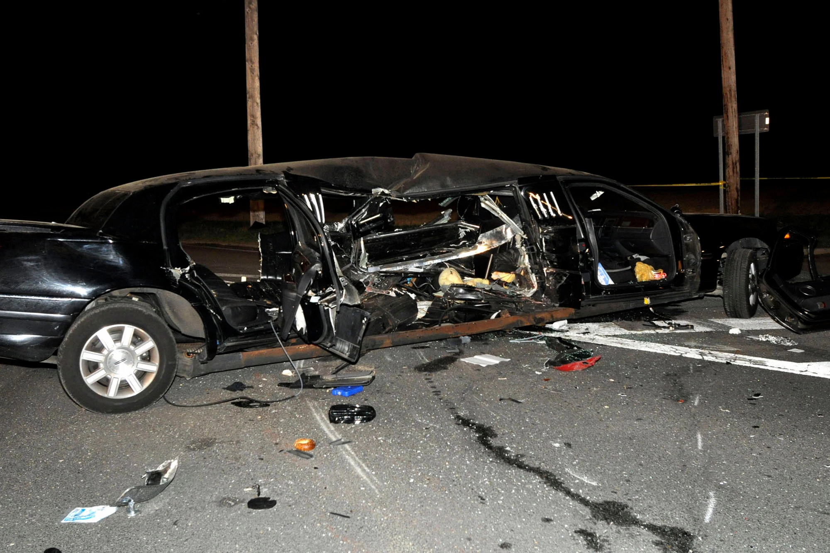
Alcohol kills most drivers
Benzodiazepines are second
http://www.bast.de/Druid/EN/Final%20Conference/Presentations/Downloads/C_7.pdf?__blob=publicationFile

Slide 86
Drugged Driving Law
17 states and Western Europe, Australia, New Zealand use a legal blood limit of THC,
typically 5 ng/ml *
https://www.whitehouse.gov/sites/default/files/ondcp/issues-content/drugged-driving/nida_dd_paper.pdf

Slide 87
Problems with implementation:
Drug level does not equal impairment. Depends on drug, tolerance, individual user
Cost of drug testing for police
Impairment testing for drugs different than for alcohol
DRUG RECOGNITION EXPERTS needed to perform field sobriety tests
Can use sweat, urine, blood, saliva. Colorado uses blood
Rapid on site testing has high false positive rate
Fourth amendment: prohibits unreasonable search/seizures without probable cause

Slide 88
What drugs should we test for?
Federal guidelines (DOT, FAA) miss many common drugs of abuse like Percocet, Vicoden, Oxycontin, Xanax, Ativan, Valium, Ritalin
These tests also miss newer drugs like Bath Salts and Synthetic marijuana
https://www.whitehouse.gov/sites/default/files/ondcp/issues-content/drugged-driving/nida_dd_paper.pdf

Slide 89
Should we do random roadside testing?
Australia does!
https://www.whitehouse.gov/sites/default/files/ondcp/issues-content/drugged-driving/nida_dd_paper.pdf

Slide 90
Marijuana regulation: Should it be a Federal function?
Marijuana is illegal at the federal level
Transporting legal marijuana from Colorado to Nebraska or Oklahoma is illegal and a federal crime
CO being sued by NE and OK due to costs of crime

Slide 91
Marijuana regulation: Should it be a Federal function?
In the US (state function):
Sales
Distribution
In Canada (federal function):
Dosage
Purity
Growing practices
The states control the commerce but not the quality and dosage.
The potency of cannabis has increased since 1960

Slide 92
BUSTED!
Do DUI educational programs work? No evidence
Must connect to treatment
EU and Australia way ahead of us
Need better lab technology
https://www.whitehouse.gov/sites/default/files/ondcp/issues-content/drugged-driving/nida_dd_paper.pdf

Slide 93
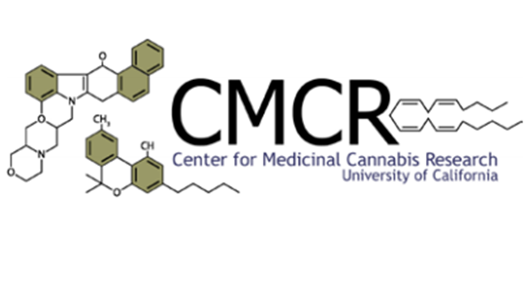
FUTURE Current U.S. research on Cannabis:
“The use of MJ increases the risk of drugged driving ‘slightly’ and much less than alcohol”

Slide 94
FUTURE The FDA has recently given the DEA new scheduling recommendations
They are secret!
BUT changes may be coming by summer according to interagency memo

Slide 95
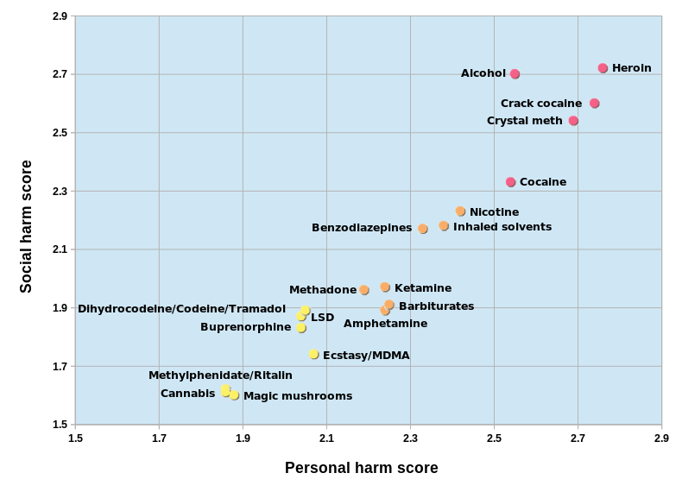
https://commons.wikimedia.org/w/index.php?curid=46501845

Slide 96
Addiction references
NIDAs handbook “Seeking drug abuse treatment: Know what to ask”
https://findtreatment.samhsa.gov
1-800-662-HELP
www.drugfree.org for parents of addicts
https://drugpubs.drugabuse.gov for free publications in the mail
The Teenage Brain by Frances Jensen
Don’t forget your EAP!

